Slide 1

The role of dynamic topography in the coupled climate system:
An open question awaiting answers in present-day and past climate
A PhD thesis proposal
Alessandro Storer – 04.06.2025

Slide 2

Academic formation and current activity
2019-2022 BSc. in Physics
University of Milan
Review of the comparison between state-of- the-art reanalysis ERA5 and observational data over normal values and long-term trends
2022-2024 MSc. in Environmental Meteorology
University of Trento - University of Innsbruck (double degree)
Studying the mesoscale coupling between atmosphere and ocean in a high-resolution simulation: how are the marine boundary layer and heat fluxes impacted by the SST anomalies?
2025 – current Junior research assistant and tutoring in “Physics of the sea”
University of Milan Bicocca
Refining thesis results - one proceeding (under revision) and one full article (finalizing draft)
Supporting teaching

Slide 3






Slide 4

Atmospheric
Boundary Layer
T , q air
wind
SST, q source
Turbulent fluxes
LHF, SHF
currents
Notes:
the coupling between marine shallow
trade-wind clouds and circulation is known to play a cen-
tral role in the uncertainty of the tropical cloud feedback and climate sensitivity estimated by models

Slide 5
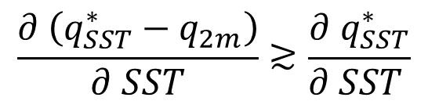
Graphical summary
Lively thermo - / dynamics at the mesoscale!
MABL’
MABL moisture set by
SURFACE EVAPORATION
MABL TOP ENTRAINMENT
Feedback on surface evaporation
$$\frac{∂ \left(q_{SST}^{∗}−q_{2m}\right)}{∂ SST}≳\frac{∂{ q}_{SST}^{∗}}{∂ SST }$$
SST’ < 0
SST’ > 0

Slide 6
Dynamic topography and climate

Slide 7
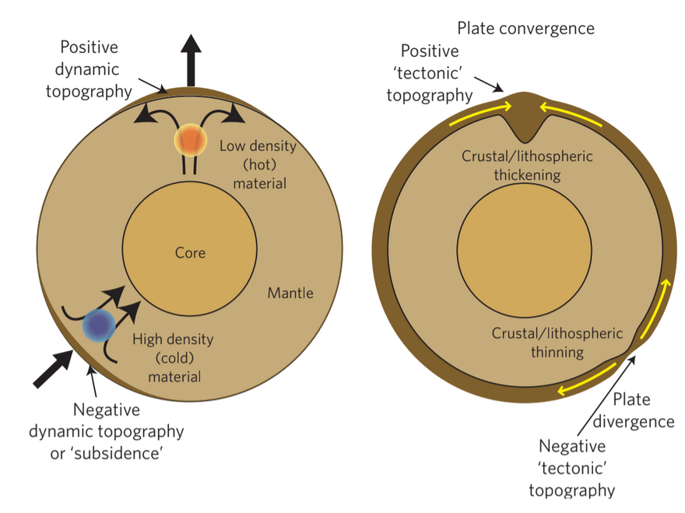
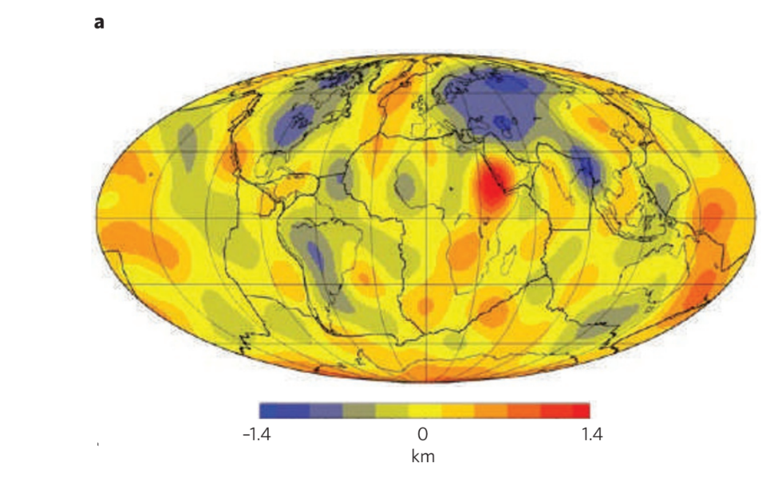
Background
Jean Braun, 2010
Figs. 1, 2
Notes:
Seismic tomography imaging
While much
of Earth’s topography arises from isostatic support due to variations in crustal and
lithospheric thickness and density, a significant portion of up to 1-2km results from
dynamic forces driven by slow yet vigorous mantle convection.
The topography of Earth is primarily controlled by lateral differences in the
density structure of the crust and lithosphere.
In addition to this isostatic topography, flow in the mantle induces deformation of its surface leading to dynamic topography

Slide 8
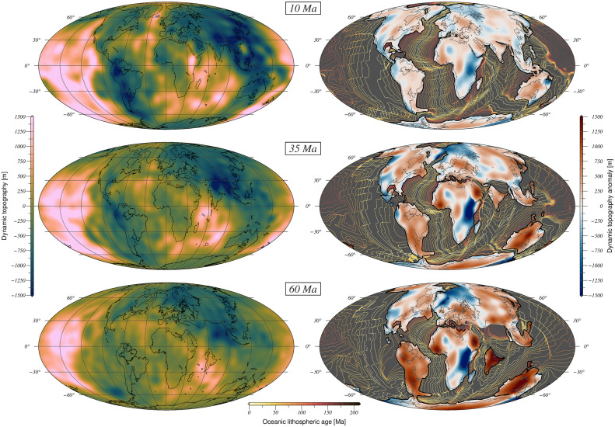
Background
Straume et al., 2024

Slide 9
Background
Application to paleotopography and paleoclimate reconstructions studies
Straume et al., 2024

Slide 10
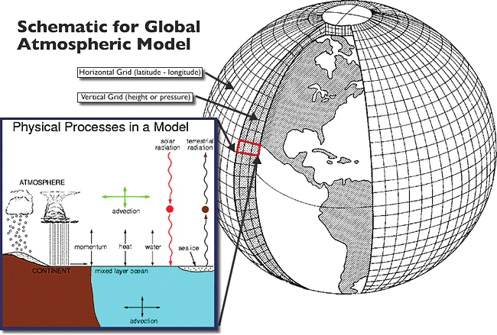

Methods

Slide 11
Methods

Slide 12
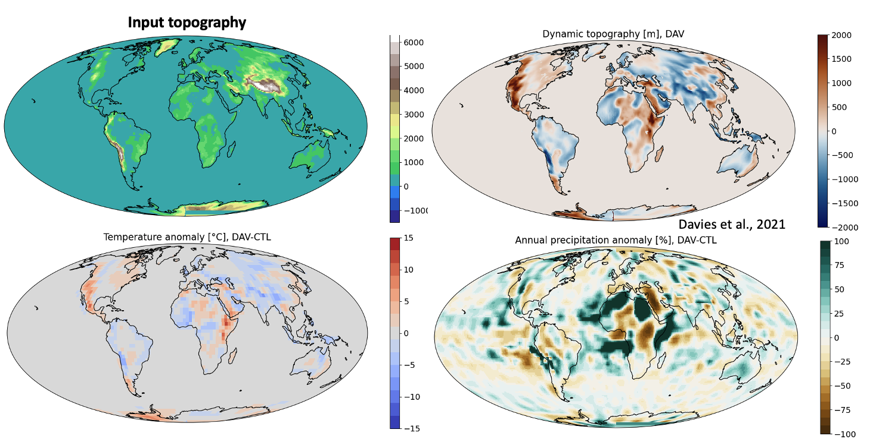
Preliminary results
Sternai et al., 2025

